Slide 1
Iteration

Slide 2
We’re going to cover…
at a high level for now
Talk about what iteration is
Talk about determinstic vs non-deterministic loops
Have a look at a few examples in doing so
Draw out some important considerations

Slide 3
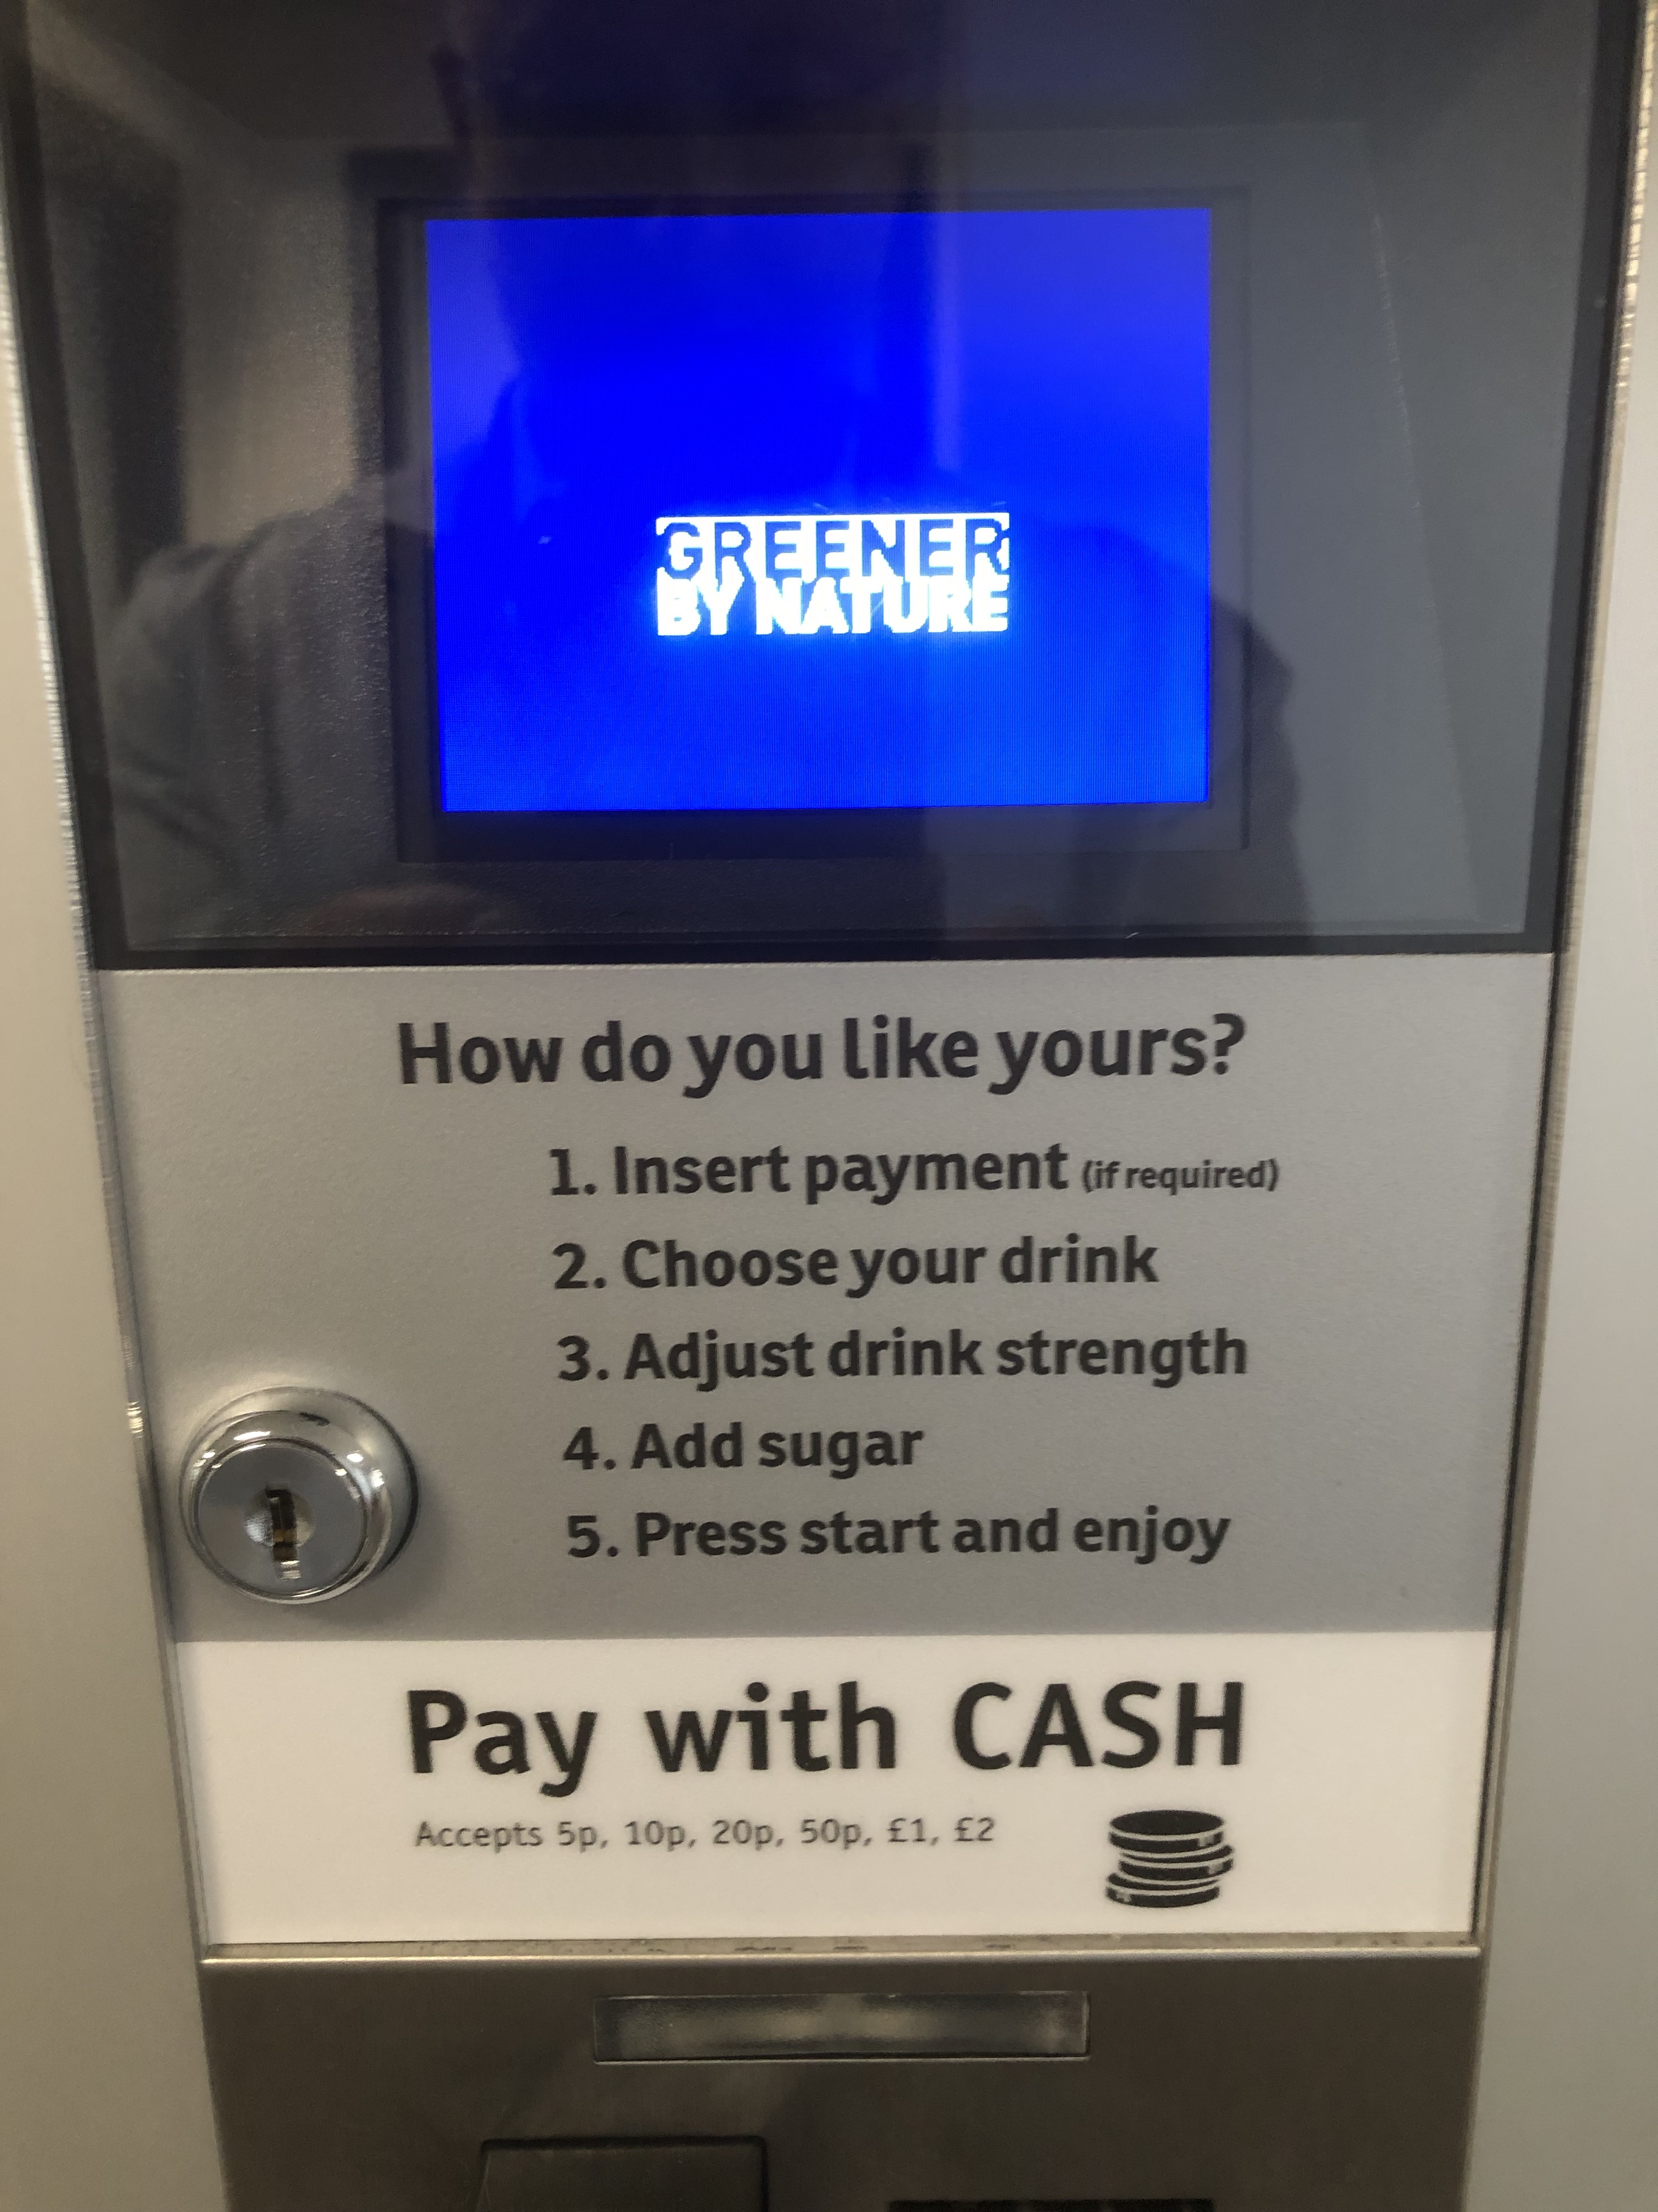
Everyday example of selection
let's start with a recap
Insert payment (if required)
Required
Not required
Choose your drink
Coffee?
Tea?
Hot Chocolate?
Adjust drink strength
Weak?
Normal?
Strong?
Add sugar
Add?
Don't add?
Press start and enjoy
we saw that there were choices to be made here

Slide 4
Everyday example of iteration?
start here (from the user's perspective)
Insert payment (if required)
Required
Not required
completing the loop
Choose your drink
Press start and enjoy
Coffee?
Tea?
Hot Chocolate?
Add sugar
Adjust drink strength
Add?
Don't add?
Weak?
Normal?
Strong?

Slide 5
Everyday example of iteration?
but what condition has to be satisfied for the loop to begin?
from the user's viewpoint
insert payment?
select drink?
do I want a(nother) drink?
is the machine operational?
Insert payment (if required)
Required
Not required
completing the loop – drink dispensed?
from the machine's viewpoint
Choose your drink
Press start and enjoy
Coffee?
Tea?
Hot Chocolate?
Add sugar
Adjust drink strength
Add?
Don't add?
Weak?
Normal?
Strong?

Slide 6
Everyday example of iteration?
what condition stops the loop if it isn't satisfied?
the machine has to be operational
power on?
drink cups available
hot water available
Insert payment (if required)
Required
Not required
completing the loop – drink dispensed?
Choose your drink
Press start and enjoy
Coffee?
Tea?
Hot Chocolate?
I don't think we'd need to check for this!
Add sugar
Adjust drink strength
Add?
Don't add?
Weak?
Normal?
Strong?

Slide 7
Everyday example of iteration?
given these conditions, can we determine when the loop will end before it happens?
Insert payment (if required)
Required
Not required
drink cups available
hot water available
completing the loop – drink dispensed?
is the loop deterministic?
or non-deterministic?
Choose your drink
Press start and enjoy
Coffee?
Tea?
Hot Chocolate?
Add sugar
Adjust drink strength
Add?
Don't add?
Weak?
Normal?
Strong?

Slide 8
Iteration
?
What is iteration?
Repetition of one or more actions, zero or more times
You must consider
The actions that occur before the loop
The number of times the loop will repeat
The actions that will repeat as a part of the loop
The actions that occur when the loop has completed

Slide 9
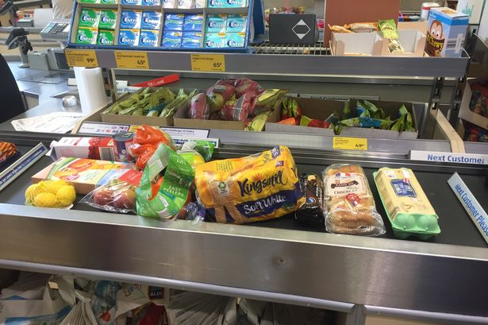
Iteration
Run shopping items through the till
Action(s) before?
Deterministic or non-deterministic?
Action(s) to be repeated?
Action(s) after?
what is the loop condition?

Slide 10
Iteration
Run shopping items through the till
Action(s) before?
Deterministic or non-deterministic?
Action(s) to be repeated?
Action(s) after?
move items from the basket to the conveyor belt
what is the loop condition?

Slide 11
Iteration
Run shopping items through the till
Action(s) before?
Deterministic or non-deterministic?
Action(s) to be repeated?
Action(s) after?
move items from the basket to the conveyor belt
what is the loop condition?
for each item on the conveyor belt

Slide 12
Iteration
Run shopping items through the till
Action(s) before?
Deterministic or non-deterministic?
Action(s) to be repeated?
Action(s) after?
move items from the basket to the conveyor belt
what is the loop condition?
for each item on the conveyor belt
scan the item
place it for bagging

Slide 13
Iteration
Run shopping items through the till
Action(s) before?
Deterministic or non-deterministic?
Action(s) to be repeated?
Action(s) after?
move items from the basket to the conveyor belt
what is the loop condition?
for each item on the conveyor belt
scan the item
place it for bagging
process payment

Slide 14
Iteration
Run shopping items through the till
Action(s) before?
Deterministic or non-deterministic?
Action(s) to be repeated?
Action(s) after?
deterministic or non-deterministic?
are there any other loops in this scenario?
how many shopping baskets will be processed during the day?

Slide 15
Iteration
1 x 5 = 5
2 x 5 = 10
3 x 5 = 15
4 x 5 = 20
5 x 5 = 25
6 x 5 = 30
7 x 5 = 35
8 x 5 = 40
9 x 5 = 45
10 x 5 = 50
Reciting the five times table up to 10
deterministic or non-deterministic?
what is the condition to enter an iteration?

Slide 16
Iteration
1 x 5 = 5
2 x 5 = 10
3 x 5 = 15
4 x 5 = 20
5 x 5 = 25
6 x 5 = 30
7 x 5 = 35
8 x 5 = 40
9 x 5 = 45
10 x 5 = 50
Reciting the five times table up to 10
deterministic or non-deterministic?
what is the condition to enter an iteration?
this number has to be less than or equal to…

Slide 17
Iteration
1 x 5 = 5
2 x 5 = 10
3 x 5 = 15
4 x 5 = 20
5 x 5 = 25
6 x 5 = 30
7 x 5 = 35
8 x 5 = 40
9 x 5 = 45
10 x 5 = 50
Reciting the five times table up to 10
what action(s) are repeated?

Slide 18
Iteration
1 x 5 = 5
2 x 5 = 10
3 x 5 = 15
4 x 5 = 20
5 x 5 = 25
6 x 5 = 30
7 x 5 = 35
8 x 5 = 40
9 x 5 = 45
10 x 5 = 50
Reciting the five times table up to 10
what action(s) are repeated?
the five times table needs to be calculated one number at a time

Slide 19
Iteration
1 x 5 = 5
2 x 5 = 10
3 x 5 = 15
4 x 5 = 20
5 x 5 = 25
6 x 5 = 30
7 x 5 = 35
8 x 5 = 40
9 x 5 = 45
10 x 5 = 50
+ 1 =
+ 1 =
Reciting the five times table up to 10
+ 1 =
+ 1 =
what action(s) are repeated?
+ 1 =
+ 1 =
this number increments by 1 on each iteration
(else the loop would never end!)
(Python has an alternative approach!)
+ 1 =
+ 1 =
+ 1 =

Slide 20
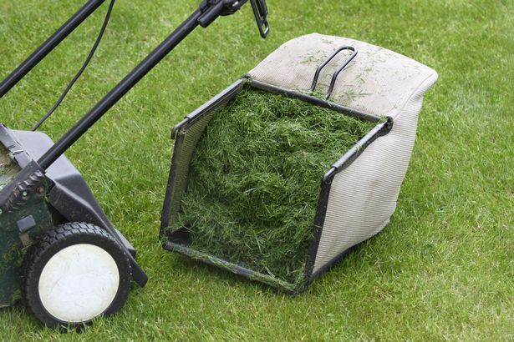
Iteration
Mowing the lawn
Deterministic or non-deterministic?
Action(s) to be repeated?
what is the loop condition?
mow every weekend?
mow if grass length exceeds 3.5 inches?

Slide 21
Iteration
Important points
Know when you're dealing with a deterministic loop and know when you're dealing with a non-deterministic loop
If it's a non-deterministic loop make sure that there is an end condition that will actually happen
Consider what actions are to be repeated within the loop
Consider what actions take place before the loop and after the loop
(my mistake when agreeing to mow the lawn!)

Slide 22
Any questions?

